Slide 1
GANs
&
RNNs
An adventure in machine learning

Slide 2
What you will take away…
The basics of GANs and RNNs
The process of creating a learning model
When to use certain models

Slide 3
The Mission:
To generate new cards for existing card games i.e. Hearthstone

Slide 4

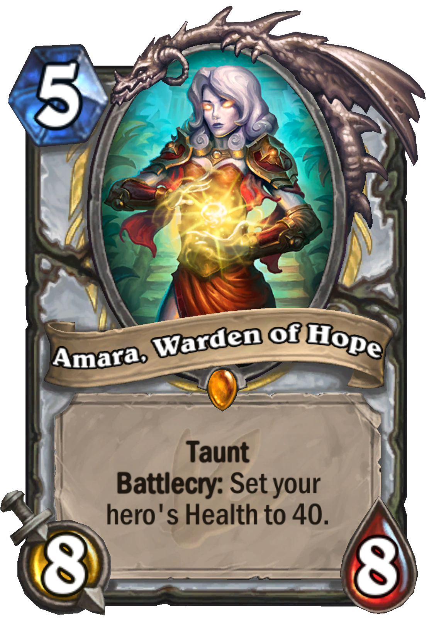
The Mission:
To generate new cards for existing card game i.e. Hearthstone

Slide 5
01
Basics of
Models

Slide 6
GAN
(Generative Adversarial Network)
Generator
Discriminator

Slide 7
GAN
(Generative Adversarial Network)
Generator
Random Noise
Fake Data

Slide 8
GAN
(Generative Adversarial Network)
Real Data
Discriminator
0 or 1
Generator

Slide 9
Loss Functions
Generator
Discriminator
min log [ 1 - D( G(x) ) ]
max log [ D(x) ]

Slide 10
Competition
Generator
Discriminator

Slide 11
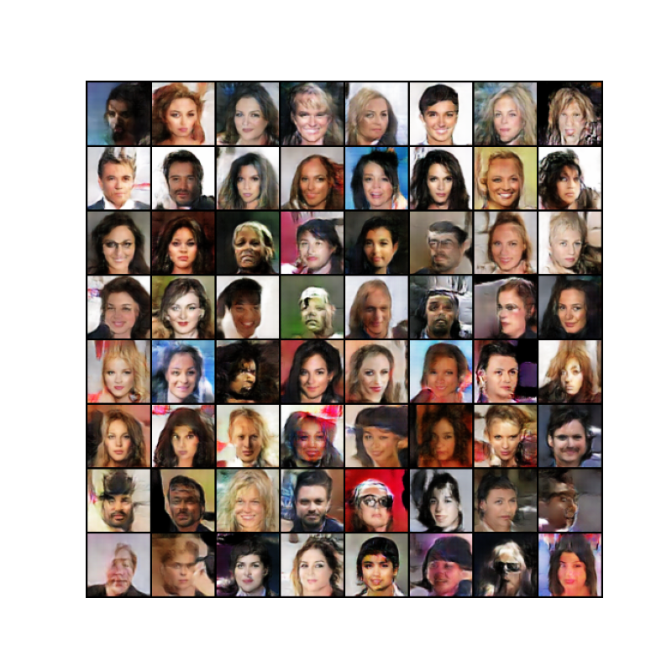
End Result
Credit: DCGAN Tutorial on PyTorch by Nathan Inkawhich

Slide 12
RNN
(Recurrent Neural Network)
Model

Slide 13
N-Gram
(Sentence Probability)
Sentence = “I Play Video Games”
Unigram:
P(Sentence) =
P(I)
P(Play)
P(Video)
P(Games)
Bigram:
P(Sentence) =
P(I)
P(Play | I)
P(Video | Play)
P(Games | Video)
Trigram:
P(Sentence) =
P(I)
P(Play | I)
P(Video | I Play)
P(Games | Play Video)

Slide 14
RNN
(Training)
Start with your large dataset of text:
…This is a simple sentence…
1-Step:
Choose a Window (number of words)
A Simple Sentence
We want to train our model to maximize:
P(Simple | A) = 1
P(Sentence | A Simple) = 1
Repeat for may steps over several epochs…

Slide 15
End Result
QUEENE:
I had thought thou hadst a Roman; for the oracle,
Thus by All bids the man against the word,
Which are so weak of care, by old care done;
Your children were in your holy love,
And the precipitation through the bleeding throne.
BISHOP OF ELY:
Marry, and will, my lord, to weep in such a one were prettiest;
Yet now I was adopted heir
Of the world's lamentable day,
To watch the next way with his father with his face?
Credit: Text Generation with an RRN on TensorFlow

Slide 16
02
My Story

Slide 17
My Idea
To Create a DCGAN that creates Hearthstone card text instead of images

Slide 18
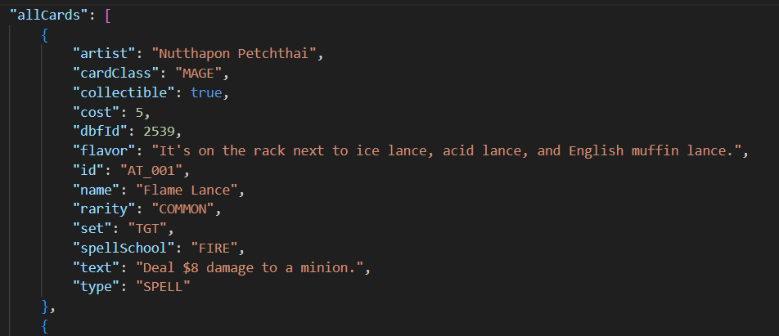
My Idea
Step 1: Data

Slide 19
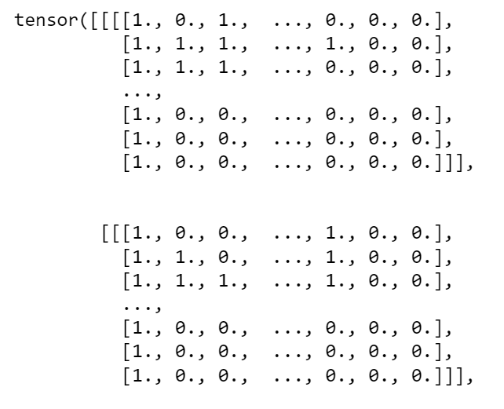
My Idea
Step 2: Format Real Data
-String Format
-ASCII
-Binary
-Multidimensional Tensor

Slide 20
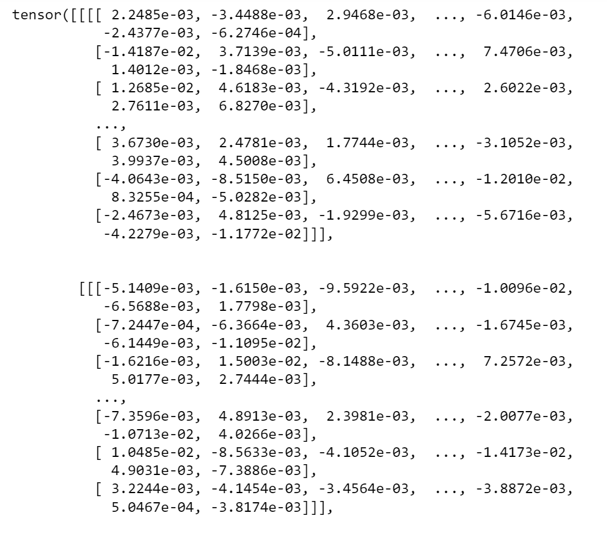
My Idea
Step 3: Test It & Compare

Slide 21
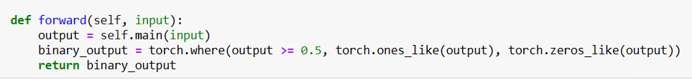
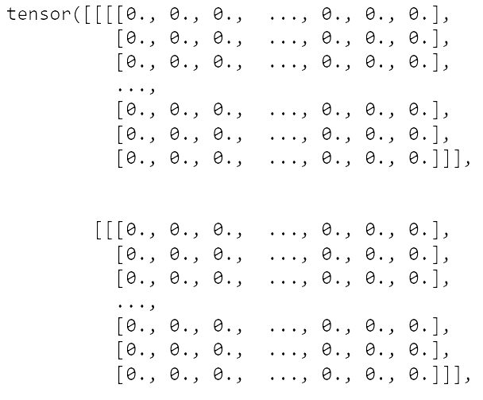
My Idea
Step 4: Update Model

Slide 22
My Idea
Step 5: Give Up

Slide 23
My Idea
Step 5: Fall Down
& Get Back Up

Slide 24
My Idea
Step 6: RNN
-Format Data (one long string)
-Feed it to the model
-Learn
-Test it Out

Slide 25
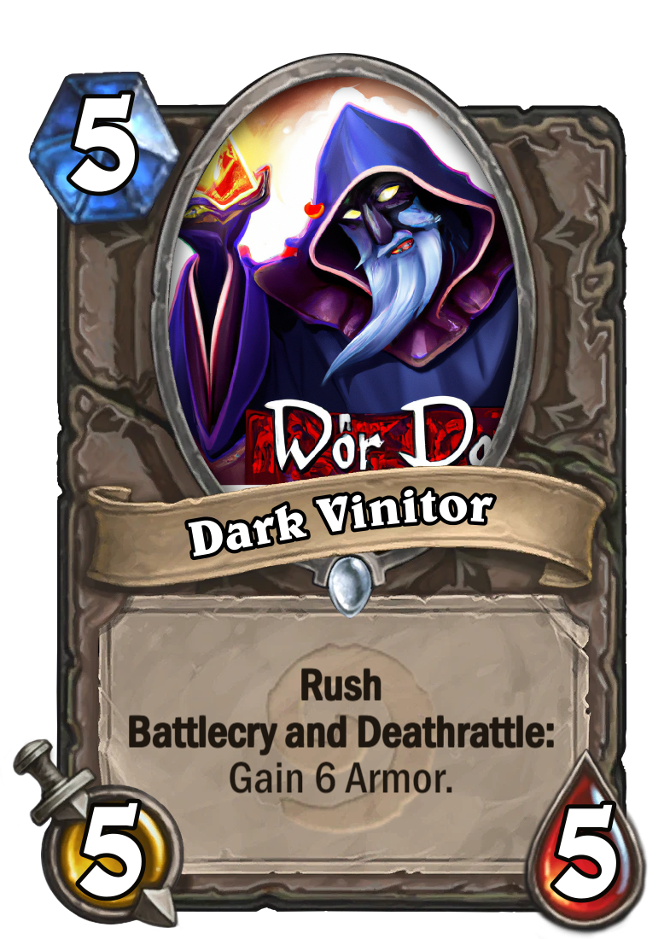
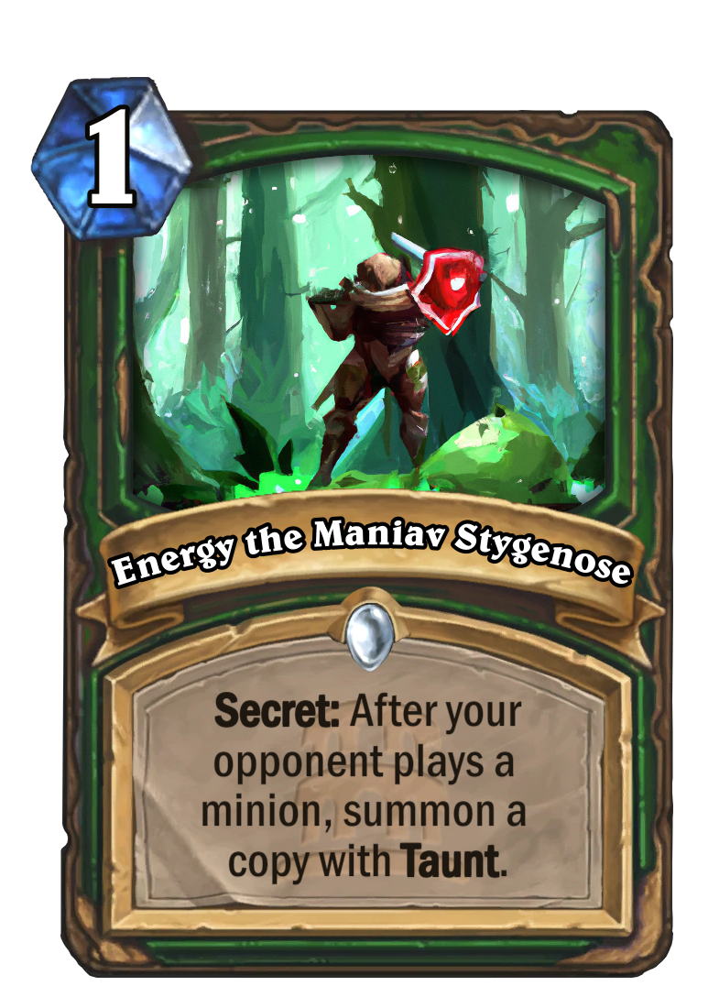
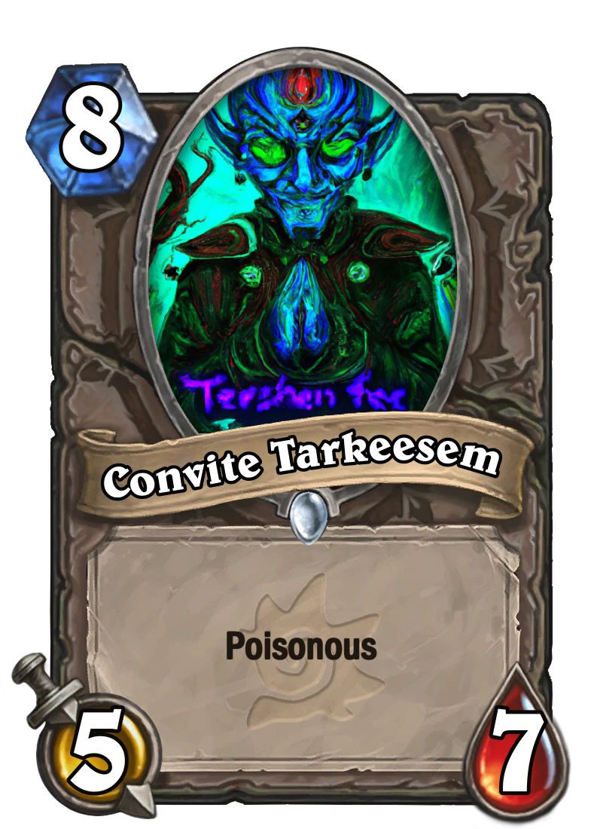
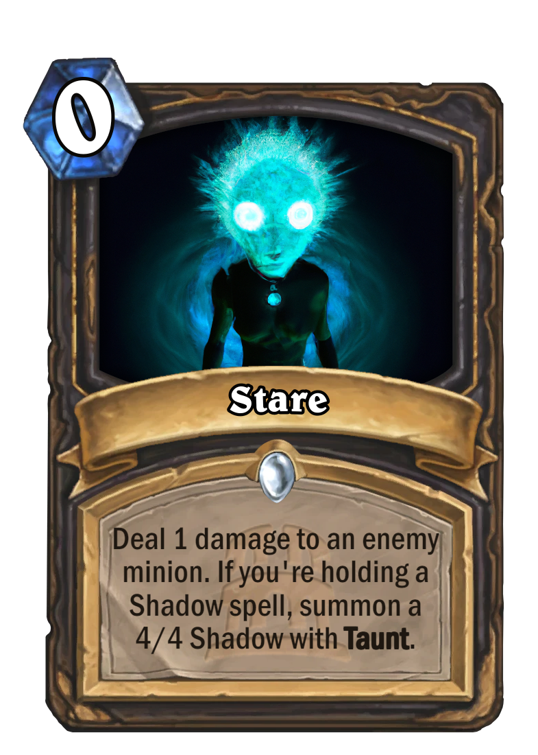
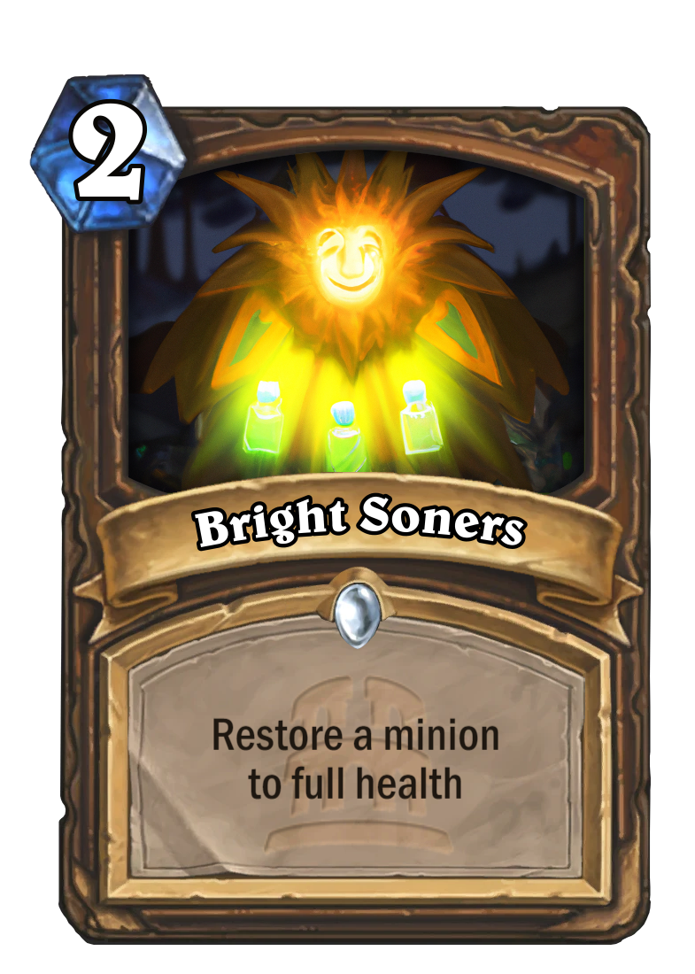
The Result
Image Credit: DALL·E 2

Slide 26
THANK YOU

